Slide 1

BUG TRACKING SYSTEM
Code Fury Project

Slide 2

Team : Impostors
WFS – 3
Team 1 : Impostors
Abhishek Manish Agarwal
Nehal Goyal
Ankit Kashyap
Sarthak Mohanty
Madhura Satao
Aishwarya Thakur
Raghav Kamra
Gayatri Walve
Shreyas Tekawade
Pragati Agarwal

Slide 3
APPLICATION FEATURES
Track bugs
Assign bugs to respective team developers
Report Bugs
Add user
Import User details
Get a overview of the bugs and the teams solving them

Slide 4
UI SNAPSHOTS

Slide 5
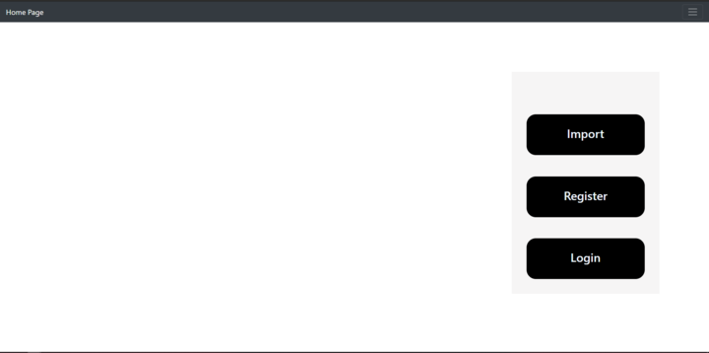
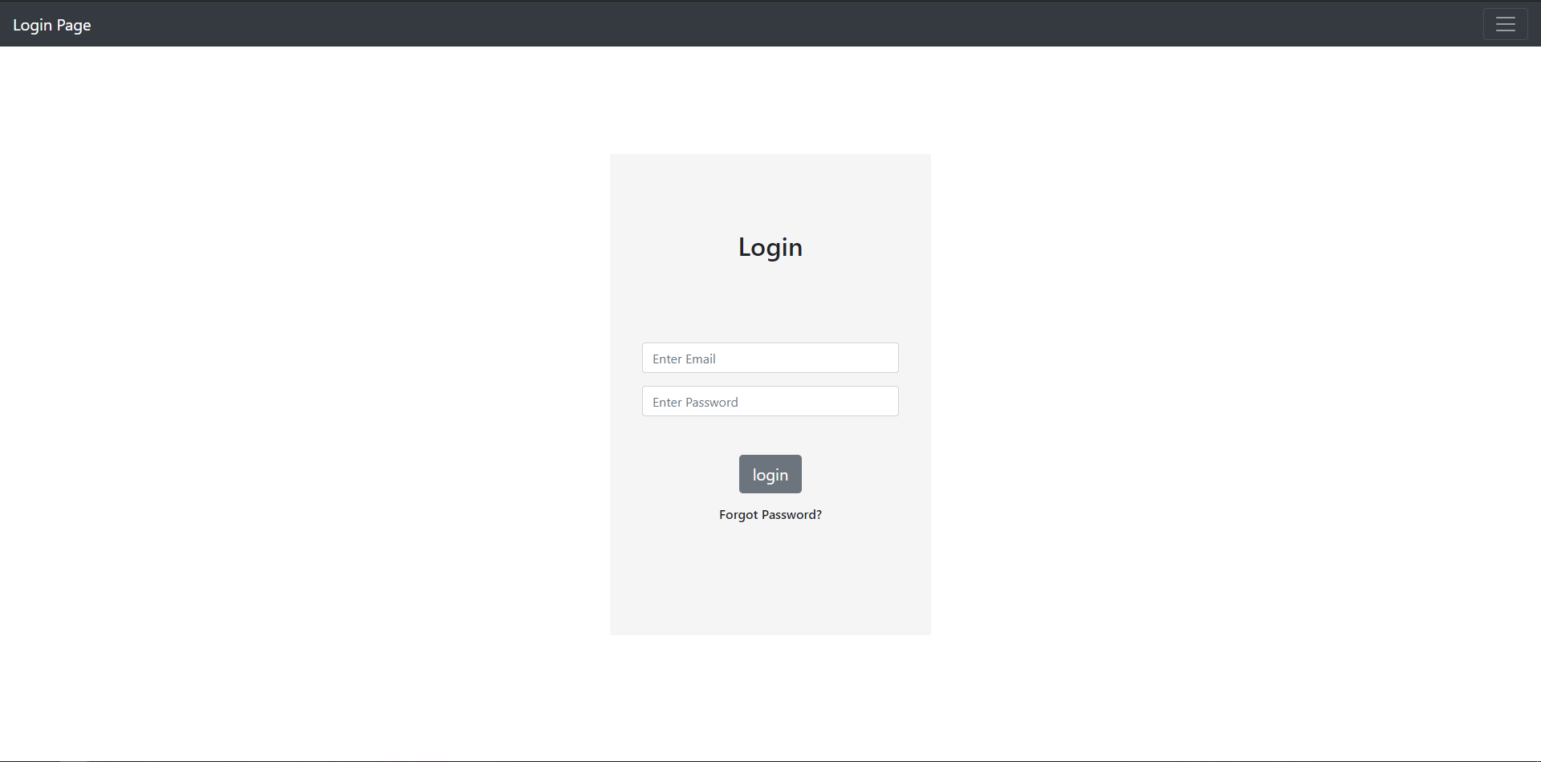

Slide 6
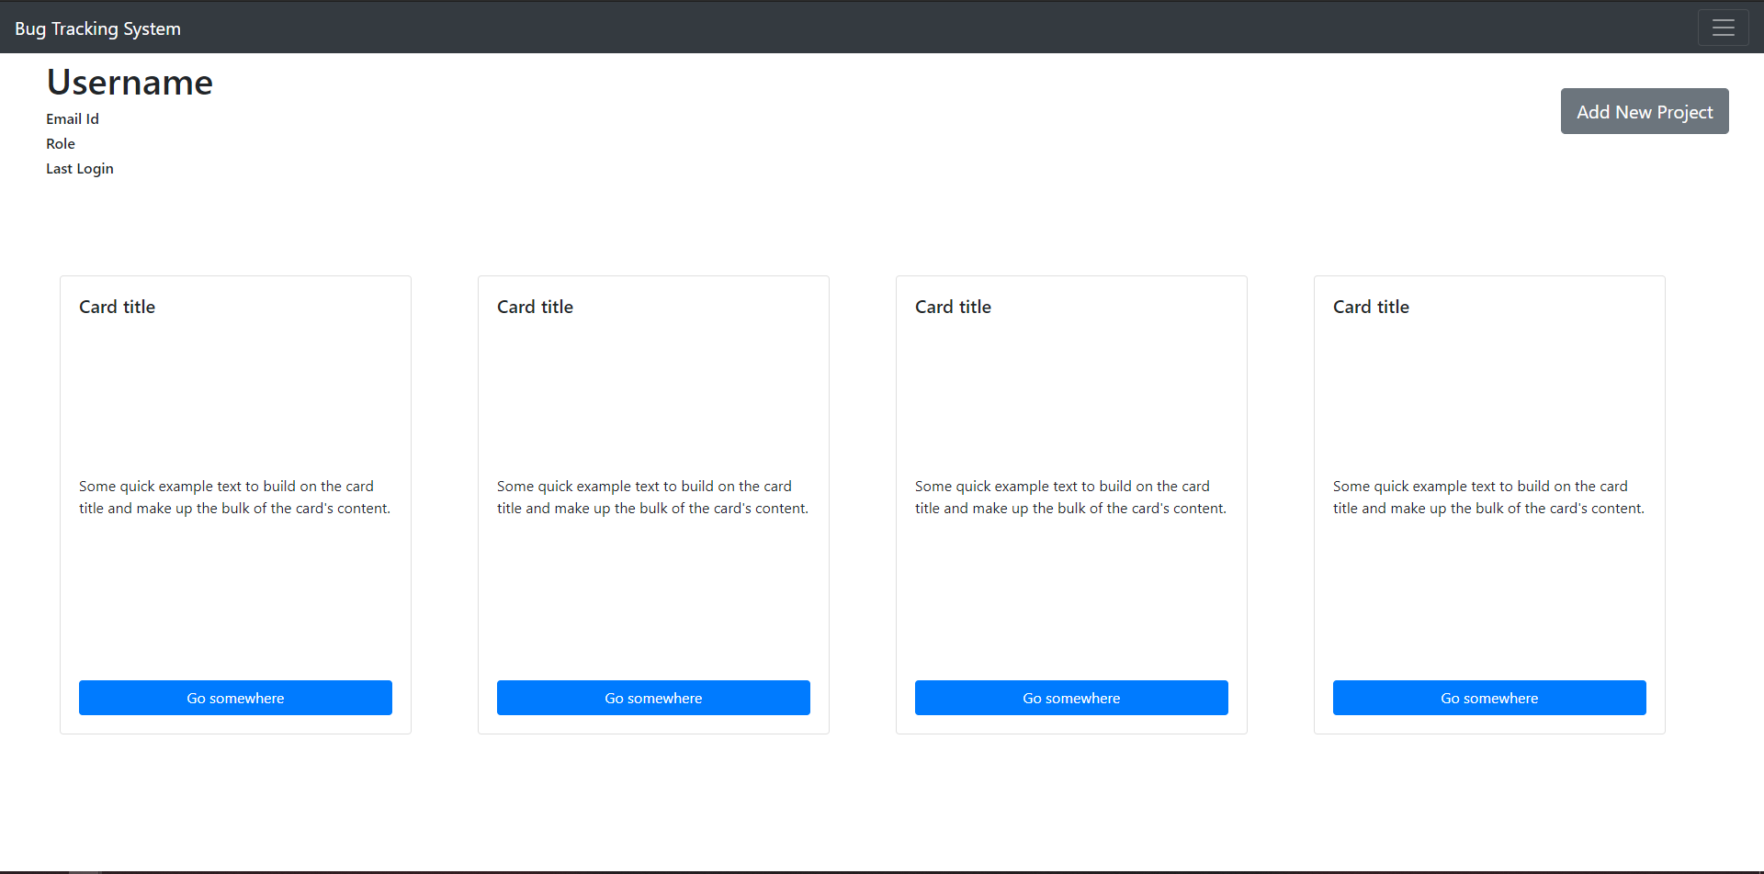

Slide 7
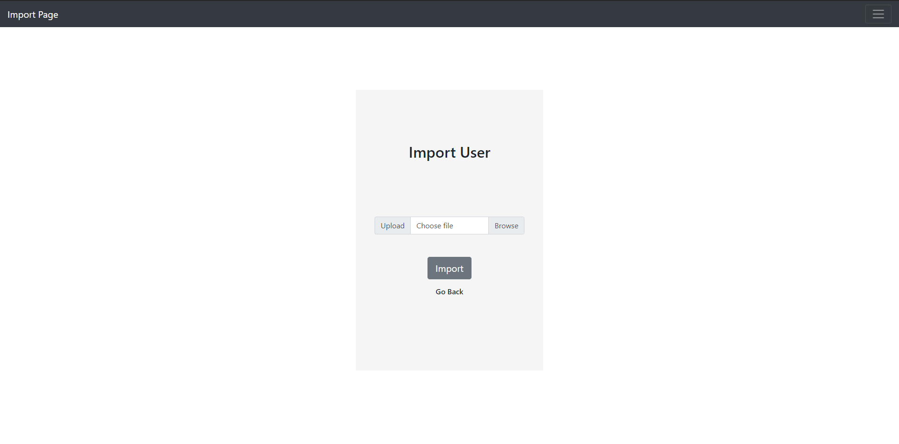
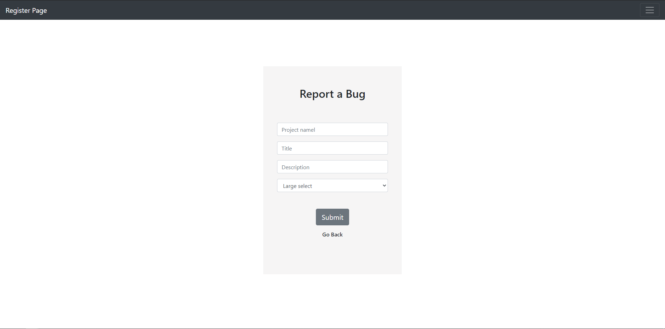

Slide 8
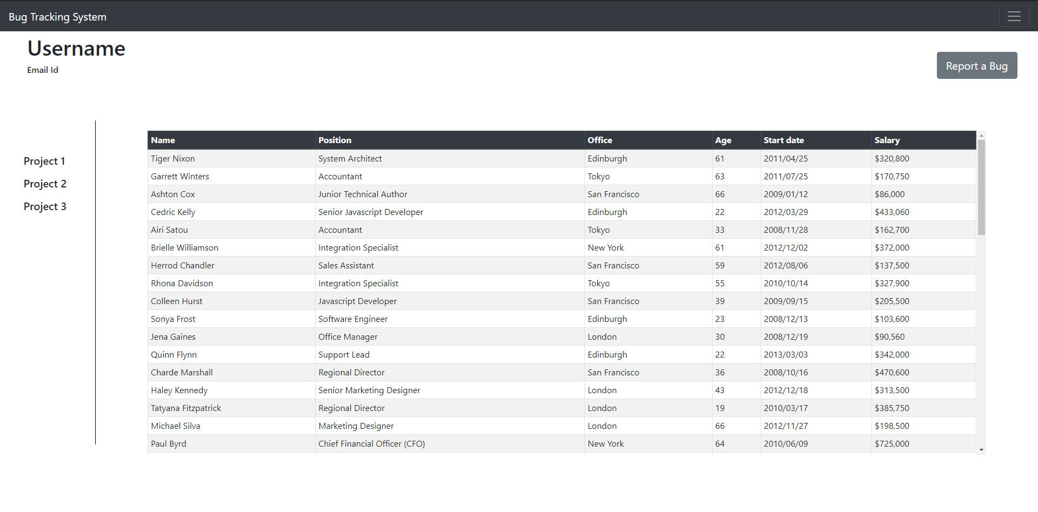

Slide 9
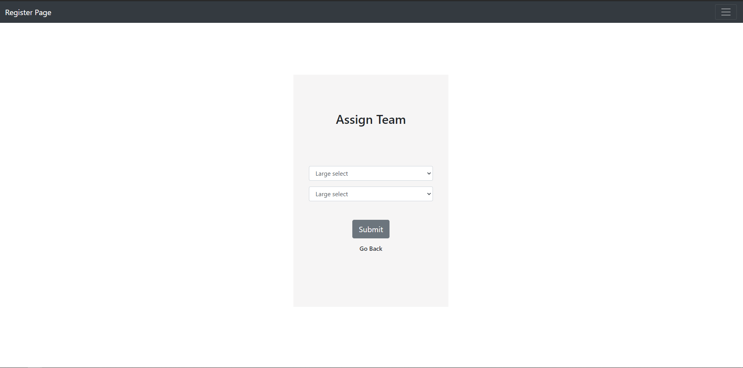
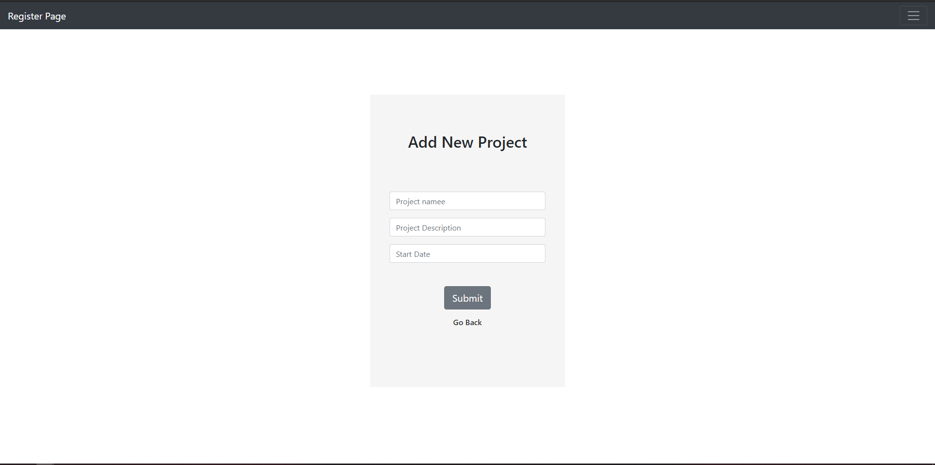

Slide 10



LEARNING
CONCEPT
COLLABORATION
TOOLS
JAVA
CSS
HTML
JAVASCRIPT
UI / UX DESIGN
GIT
SQL
1.GIT HUB
2.SLACK
3.DRAW.IO
4.ZOOM
ECLIPSE
ADOBE XD
DERBY DATABASE
GIT

Slide 11

THANK YOU!

